Slide 1

IN6206
Internet & Web Applications Development
Course Introduction

Slide 2
Agenda
Course Objective
How is the course designed?
Course Requirements
CA
Other information

Slide 3
Course Objectives
The objective of this course is to give the students an insight of the Enterprise application development – by means of learning new framework and to do coding & deployment of applications.
At the end of course, you will be able to:
  Understand the significance of enterprise application development.
  Appreciate the fundamentals of Enterprise Architecture and development frameworks.
  Learn how to develop, deploy and test enterprise applications

Slide 4
How is the course designed?
This course emphasizes learning EAD through Spring framework.
Students will learn to design and code applications using Spring framework and develop micro services using Spring Boot.
Though the course covers advanced topics, the course still covers the basics of every topic.
Bonus chapters on Angular framework will be offered.

Slide 5
Course Requirements
Technical Requirements:
  Fundamental knowledge of Java.
  Basic information on how web application works.
Attendance and Class Participation:
  Attendance is compulsory

Slide 6
CA
There won’t be any examination at the end of semester as the assessment mode would be “coursework-based”.
The CA topics and the weightage are given in the table below:
Assessment Module | Percentage
Group Assignment – 1 | 30%
Group Assignment – 2 | 30%
Individual Project | 40%

Slide 7
CA – Group Projects
Objectives:
Emphasizes on the theoretical aspects of the Enterprise Application Development
Students are expected to study a certain topic (theoretical) and demonstrate knowledge by sharing the information to the class.
Sample topics will be provided to the students. However, students are encouraged to propose their own topics relevant to the course topic.
Students will work as a group (ideally 3-4 people per group) and will present their topic to the class by means of a PPT presentation
The objective of the group assignments are to learn and share information to fellow students

Slide 8
CA – Group Projects
Deliverables:
PPT presentation to the class (15-20 mins).
Submission of report that should contain up to 2500 words. References, bibliography and any other reference material should be mentioned in the report.
The reports should be uploaded to a discussion thread in NTU Learn website.

Slide 9

CA – Group Projects
How the group projects will be graded:
All students in a group will receive the same grade.
The key criteria that decides the grades for group assignment are:
  Level of study
  Understanding of the underlying principles
  Amount of information provided
  Key areas and depth of information provided
  Relevance pertaining to topic chosen
  Choice of literature
  How relevant are the examples provided
  Presentation flow
  Time management during the presentation
  The idea is NOT to learn all, but to learn effectively.

Slide 10
CA – Individual Project
Objectives:
Emphasizes on the technical aspects of the Enterprise Application Development
Students are expected to create an application either based on the framework studied in the class or any other Java-based framework.
Sample topics will be provided to the students. However, students are encouraged to propose their own topics relevant to the course topic.
Students will work individually and will present their topic to the class by means of a live demonstration
Application may be created using Spring framework, or Angular Application using spring boot or a stand-alone Angular application.

Slide 11
CA – Individual Projects
Deliverables:
Live demonstration to the class (5-10 mins) – only for individual assignment.
The following are required to be submitted:
  Functional document – listing all the user functions developed in the application
  Technical document– describing the architecture of the application, class diagrams, entity-relationship diagrams and any other technical aspects that the student wishes to describe.
  Database dump
  Source code
All the above-described deliverables should be uploaded to a discussion thread in NTU Learn website.

Slide 12

CA – Individual Projects
How the individual projects will be graded:
The key criteria that decides the grades for individual assignment are:
  Does the application deploy and work without any issues.
  Coding standards and style
  Is the framework used in the right way?
  Any additional libraries or technical features used in the application?
  Did the student implement any key feature that uses the framework in the most efficient way?
  Time management during the presentation
  The idea is NOT to create colorful application, but to demonstrate the knowledge in the frameworks and to develop applications in the most efficient way.
    If you are using another code (or application) to build your application, declare it before hand! Make sure to mention what is your contribution. Remember: You will only be graded for your work.

Slide 13
FAQ
The course does not cover the length and breadth of all frameworks. With the limited time that we have the coverage will be at high level. Students are encouraged to do more study as industry demands are always going to be challenging.
Will I be able to sit for any certifications after this course?
  That is not the objective of this course!
What will be the approach - tactical or strategic?
  A mixture of both. The strategy is to get introduced to various frameworks and the tactics will be to get the technical exposure by means of assignments and lab exercises.
What if I have any queries?
  Please email to the lecturer. Take note that some information are worth sharing to the entire class. So, the lecturer will cascade the same information as announcement to the entire class.

Slide 14
FAQ continues..
I am not able to complete the assignment within the due date. What should I do?
  Inform the lecturer when you have issues in meeting deadlines or if you have any queries with regards to the assignment or course work.
I have issues in my code!
  While you may ask for methodology or ways to solve issues, please do not ask the lecturer to debug the code.
Take note that the class is always going to have a mixture of experienced people and beginners. As such, attention will be given to every student, as much as possible, to ensure that the lab exercise are followed.
  Be a class buddy! Help your friends ☺

Slide 15
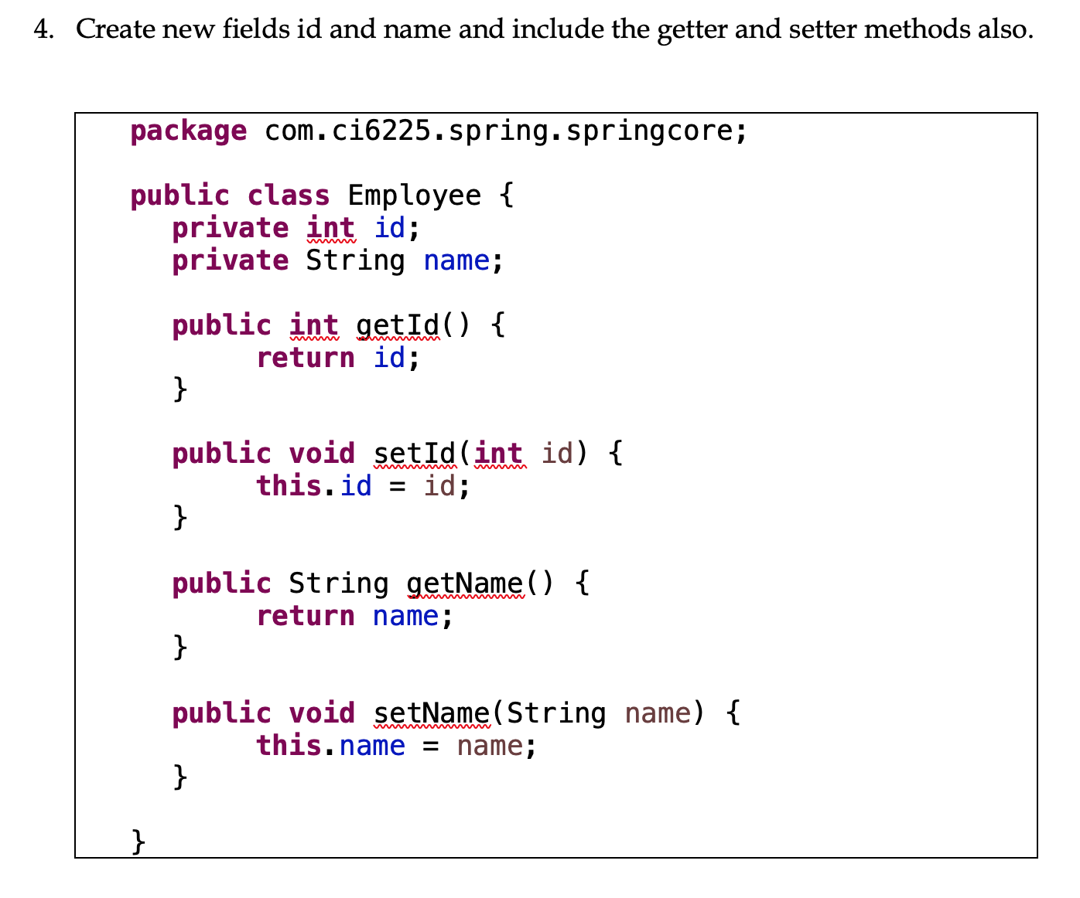
FAQ continues..
Why is the code given in the lecture material? How can I challenge myself? Should I have to use the given code compulsorily?
  The course is designed for people with little or no experience in enterprise application development.
  The code is given in the lecture material so that the entire class (including those inexperienced/aspiring developers) can be benefitted.
  You are not obliged to use the exact code in the course materials, and you may write your own!

Slide 16


